Slide 1
HTML Introducing CSS
ZhuHua

Slide 2
What is CSS
CSS is the language we use to style a Web page.
CSS stands for Cascading Style Sheets
CSS describes how HTML elements are to be displayed on screen, paper, or in other media
CSS saves a lot of work. It can control the layout of multiple web pages all at once
Eternal stylesheets are stored in CSS files

Slide 3
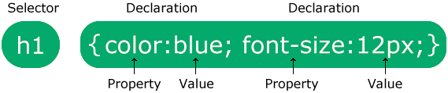
CSS Syntax
A CSS rule consists of a selector and a declaration block:
The selector points to the HTML element you want to style.
The declaration block contains one or more declarations separated by semicolons.
Each declaration includes a CSS property name and a value, separated by a colon.
Multiple CSS declarations are separated with semicolons, and declaration blocks are surrounded by curly braces.

Slide 4
Using External CSS
in an HTML document to tell the browser where to find the CSS file used to style the page.
It is an empty element (meaning it does not need a closing tag), and it lives inside the <head> element.
It should use three attributes: href This specifies the path to the CSS file (which is often placed in a folder called css or styles). type This attribute specifies the type of document being linked to. The value should be tet/css
This specifies the relationship between the HTML page and the file it is linked to. The value should be stylesheet when linking to a CSS file.

Slide 5
Using Internal CSS
You can also include CSS rules within an HTML page by placing them inside a <style> element, which usually sits inside the <head> element of the page.
The <style> element should use the type attribute to indicate that the styles are specified in CSS.

Slide 6
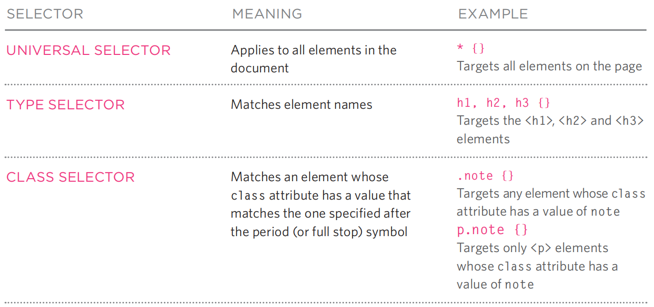
CSS Selectors

Slide 7
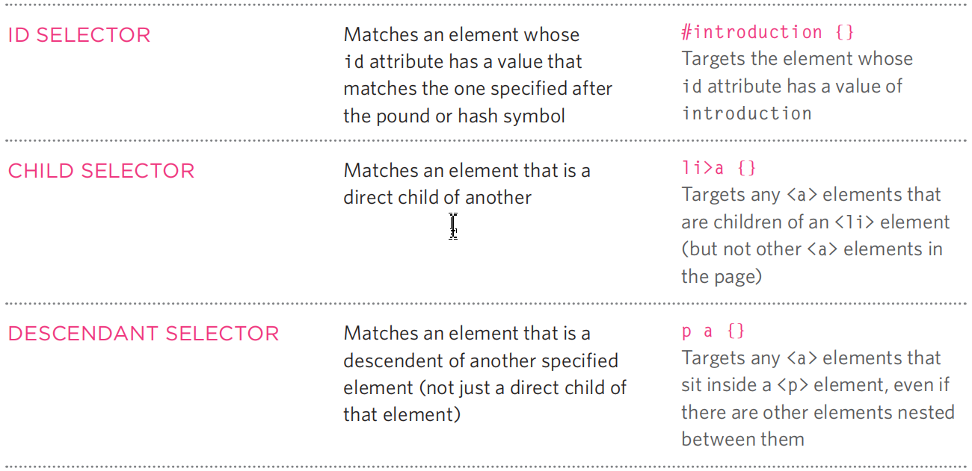
CSS Selectors

Slide 9
How Css Rules Cascade
If there are two or more rules that apply to the same element, it is important to understand which will take precedence.
LAST RULE If the two selectors are identical, the latter of the two will take precedence. Here you can see the second i selector takes precedence over the first.
SPECIFICITY If one selector is more specific than the others, the more specific rule will take precedence over more general ones. In this eample: h1 is more specific than * p b is more specific than p p#intro is more specific than p
IMPORTANT You can add !important after any property value to indicate that it should be considered more important than other rules that apply to the same element.
Notes:
color: blue !important;

Slide 10
inheritance
If you specify the font-family or color properties on the <body> element, they will apply to most child elements. This is because the value of the font-family property is inherited by child elements. It saves you from having to apply these properties to as many elements (and results in simpler style sheets).
You can compare this with the background-color or border properties; they are not inherited by child elements. If these were inherited by all child elements then the page could look quite messy.

Slide 11
Why use Eternal Style Sheets
When building a website there are several advantages to placing your CSS rules in a separate style sheet
All of your web pages can share the same style sheet. This is achieved by using the <link> element on each HTML page of your site to link to the same CSS document
If you want to make a change to how your site appears, you only need to edit the one CSS file and all of your pages will be updated.
The HTML code will be easier to read and edit because it does not have lots of CSS rules in the same document.

Slide 12
Different versions of CSS & Browser Quirks
CSS1 was released in 1996 and CSS2 followed two years later. Work on CSS3 has been ongoing but the major browsers have already started to implement it.

Slide 13
Summary
CSS treats each HTML element as if it appears inside its own bo and uses rules to indicate how that element should look.
Rules are made up of selectors (that specify the elements the rule applies to) and declarations (that indicate what these elements should look like).
Different types of selectors allow you to target your rules at different elements
Declarations are made up of two parts: the properties of the element that you want to change, and the values of those properties.
CSS rules usually appear in a separate document, although they may appear within an HTML page.

Slide 14
Questions？
Which CSS selector is used to select an element with a specific id?
*
.
#
%

Slide 15
Questions？
Which CSS selector is used to select an element with a specific id?
*
.
#
%

Slide 16
Questions？
What does the universal selector (*) do in CSS?
Selects elements with a specific id
Selects all HTML elements on the page
Selects elements with a specific class
Groups multiple selectors together

Slide 17
Questions？
What does the universal selector (*) do in CSS?
Selects elements with a specific id
Selects all HTML elements on the page
Selects elements with a specific class
Groups multiple selectors together

Slide 18
Questions？
Which of the following is the correct synta to select all <p> elements with the class 'highlight'?
p.highlight
.highlight p
p#highlight
#highlight p

Slide 19
Questions？
Which of the following is the correct synta to select all <p> elements with the class 'highlight'?
p.highlight
.highlight p
p#highlight
#highlight p

